Slide 1
Stage 1:
- Our Heuristic function is The Manhattan Distance which is the total of the absolute values of the discrepancies between the x and y coordinates of the current and the goal cells.
- H(n) = abs (curr_cell.x – goal.x) + abs (curr_cell.y – goal.y) → Thats better than calculating the real value of the Heuristics which will be much more time consuming .

Slide 2
State diagram for A* search algorithm
initialization
(0,0)
A
S
( 0,1)
F(n)=h(n)+c(x)
h(S)=2
h(A)=1
B
g
5
B
g
6
Unvisited Database
visited Database
3
S
A
4
S
A
S
_
h(b)=1
g
B
goal state
(1,0)
A
-
(1,1)
h(g)=0
B
_
#start:
-initial node is given f(x)=c(x)+h(n) , PPR= - (in this case S ; f(S)=0+2)
-other nodes are given f(x)=infinity , PPR=null.
g
_

Slide 3
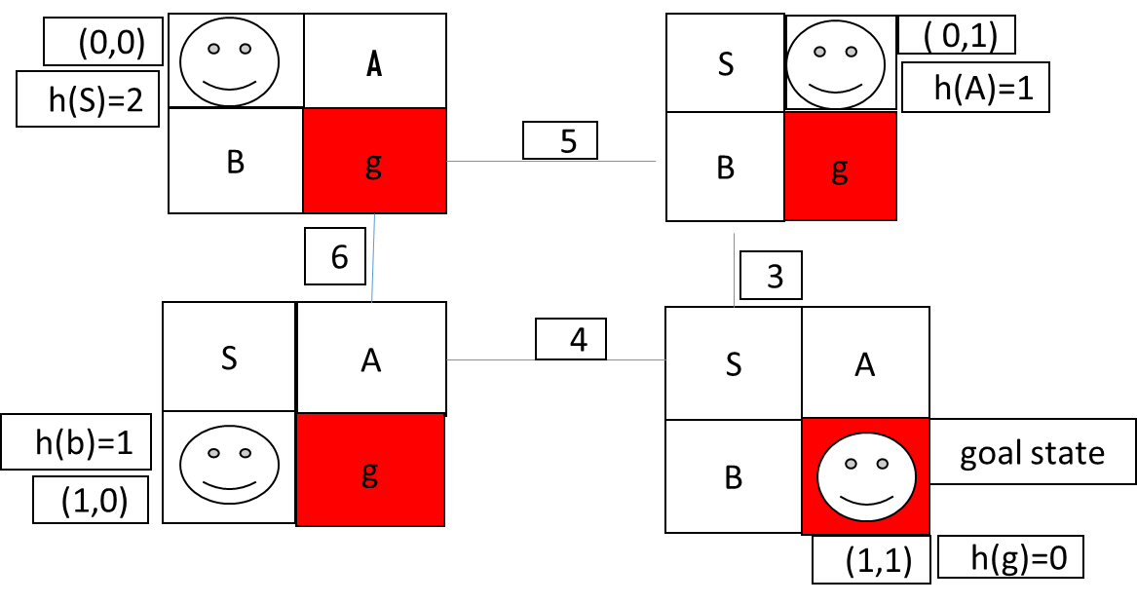
step1
Unvisited Database
visited Database
-
S
A
-
#node expansion turn:
-choose from nodes that are still in the unvisited DB
-&& has least f(x).
in this case S has least f(x).
f(x)=c(x)+h(n).
f(A)=5+1=6
F(b)=6+1=7
F(g)=infinity
B
_
G
_

Slide 4
step2
Unvisited Database
visited Database
-
S
-
A
#node expansion turn:
-choose from nodes that are still in the unvisited DB
-&& has least f(x).
in this case A has least f(x).
B
_
f(x)=c(x)+h(n).
f(A)=5+1=6
F(b)=6+1=7
f(g)=5+3+0=8
G
_

Slide 5
step3
Unvisited Database
visited Database
-
S
-
A
#node expansion turn:
-choose from nodes that are still in the unvisited DB
-&& has least f(x).
in this case B has least f(x).
f(x)=c(x)+h(n).
f(A)=5+1=6
F(b)=6+1=7
f(g)=5+3+0=8 (8<10) final results
-
B
G
_

Slide 6
(0,0)
(0,1)
unvisited
visited
(0,0)
(0,1)
unvisited
visited
H(s)=2
H(A)=1
H(s)=2
H(A)=1
F(n)=h(n)+c(n)
F(A)=1+5=6
F(B)=1+6=7
F(A)<F(B)
Then A is visited
s
A
…
S
s
A
…
S
5
5
A
…
…
A
6
3
6
3
B
G
B
…
B
G
4
B
…
4
(1,0)
(1,1)
G
…
(1,0)
(1,1)
H(B)=1
H(G)=0
G
…
H(B)=1
H(G)=0
(0,0)
(0,1)
unvisited
visited
H(s)=2
H(A)=1
F(n)=h(n)+c(n)
F(G)=5+3+0=8
Then G is visited
,total equal 8
s
A
…
S
5
…
A
6
3
B
G
B
…
4
(1,0)
(1,1)
…
G
H(B)=1
H(G)=0

Slide 7
Case(2)
(0,0)
(0,1)
unvisited
visited
(0,0)
(0,1)
unvisited
visited
H(s)=0
H(A)=1
H(s)=0
H(A)=1
F(n)=h(n)+c(n)
F(G)=7+0=7
F(B)=4+2=6
F(B)<F(G)
Then B is visited
G
A
…
S
G
A
…
S
2
2
A
…
A
…
7
1
7
1
S
B
B
…
S
B
4
…
B
4
(1,0)
(1,1)
G
…
(1,0)
(1,1)
H(B)=1
H(G)=2
G
…
H(B)=1
H(G)=2
(0,0)
(0,1)
unvisited
visited
(0,0)
(0,1)
unvisited
visited
F(G)=4+1+2+0=7
Then G is visited
H(s)=0
H(A)=1
H(s)=0
H(A)=1
G
A
…
S
G
A
…
S
2
2
…
A
…
A
7
1
7
1
S
B
…
B
S
B
…
B
4
4
(1,0)
(1,1)
G
…
(1,0)
(1,1)
…
G
H(B)=1
H(G)=2
H(B)=1
H(G)=2
F(A)=4+1+1=6
Then A is visited

